Slide 1
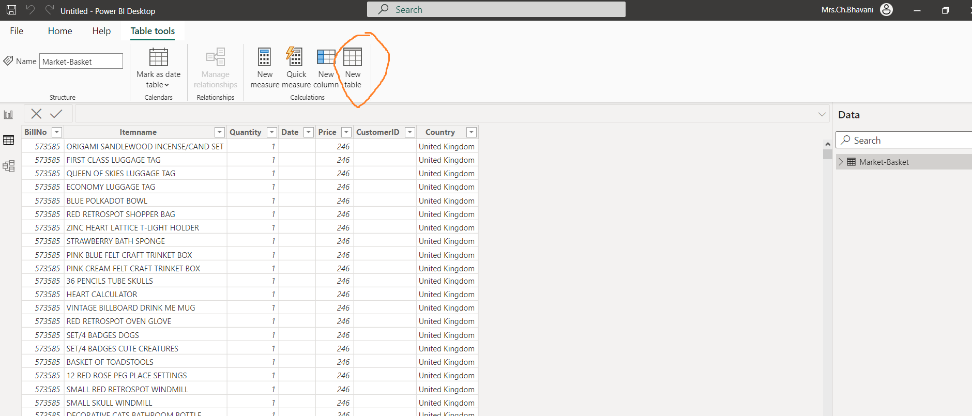
Market – Basket Analysis
Load the Market – Basket dataset (CSV Format) into Power-Bi
Go table view -> Create a duplicate table.

Slide 2
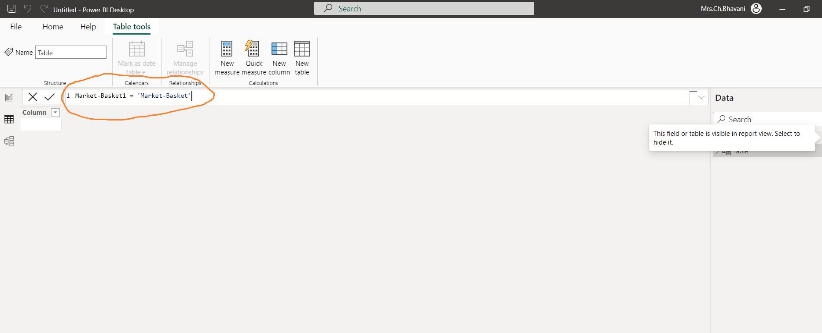
Market – Basket Analysis
3) Rename the new table in formula bar as following and click on tick mark beside it.

Slide 3
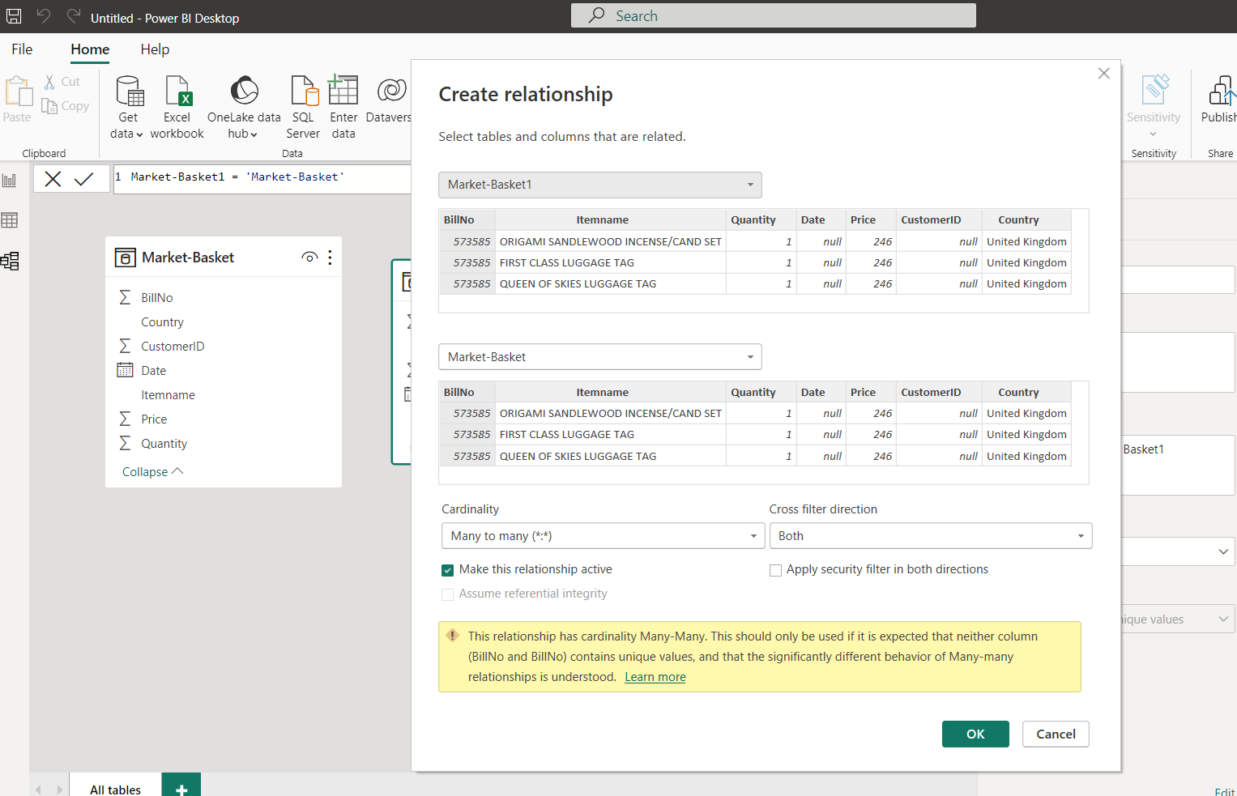
Market – Basket Analysis
4) Now go to model view and link bill num from duplicate table to original table by dragging.
A dialog box will opened, click on ok.

Slide 4
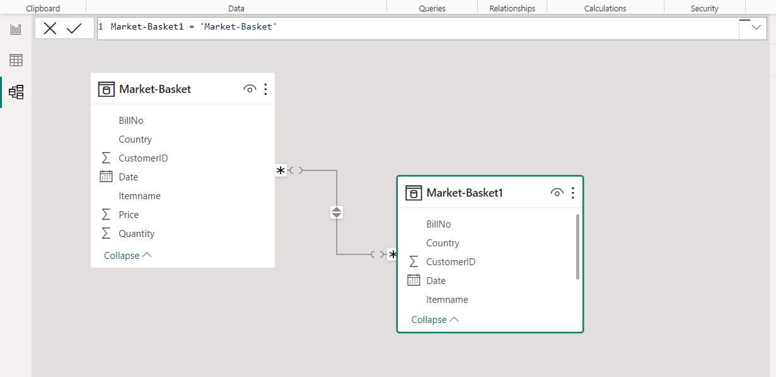
Market – Basket Analysis
A link will be formed as following

Slide 5
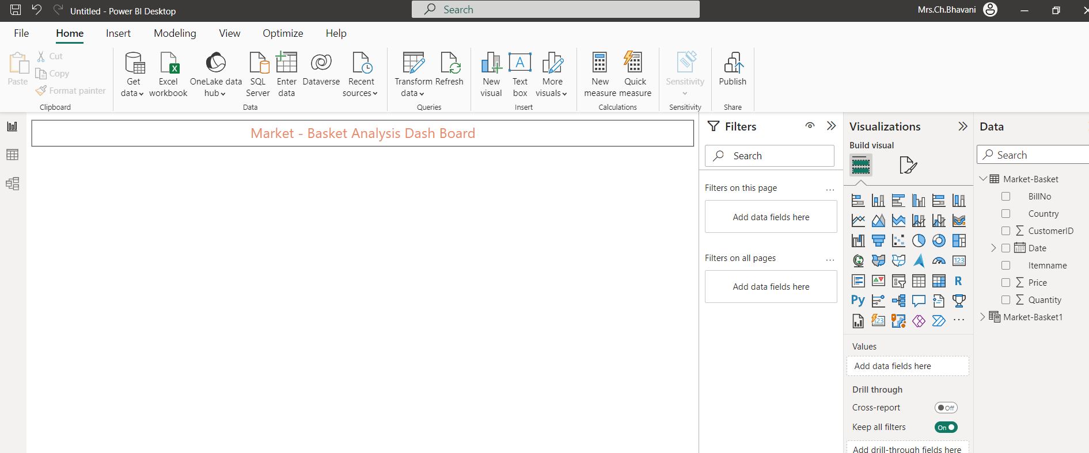
Market – Basket Analysis
5) Now go to report view, for creating the market basket analysis dash board.
On the top of the dash board add text field, for adding the heading of the dash board and turn on the visual borders in format visuals -> general -> effects

Slide 6
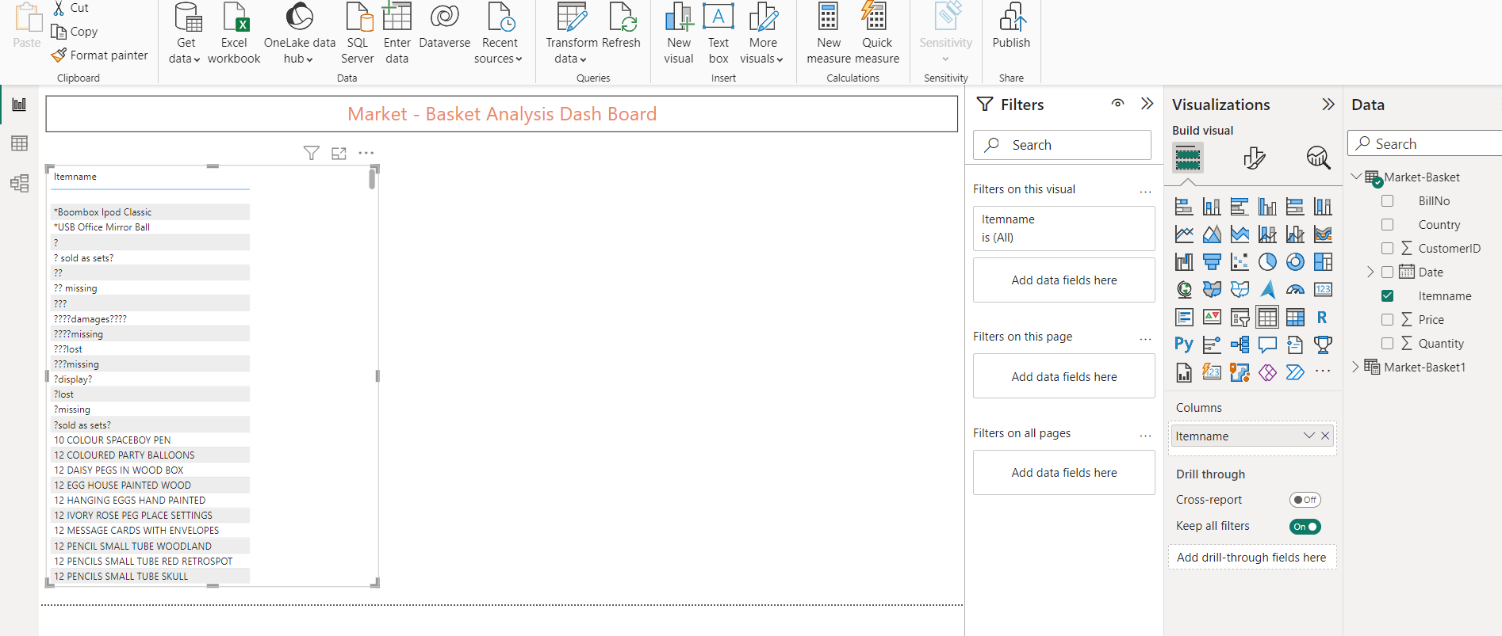
Market – Basket Analysis
6) Next, drag the itemname field from the original table to the dash board and rename the column name as Items.
And turn on the visual borders.

Slide 7
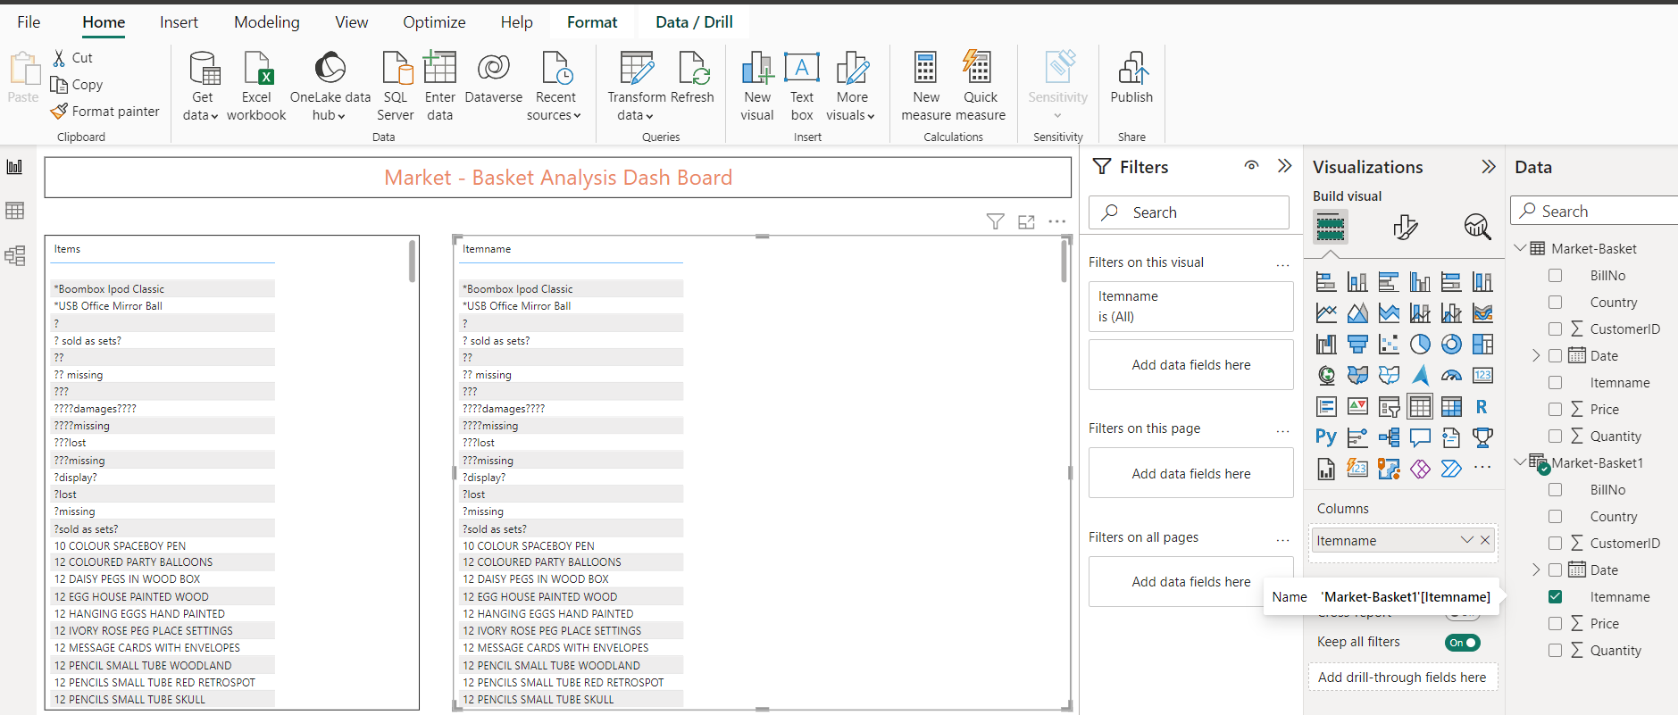
Market – Basket Analysis
7) From duplicate table drag the itemname field to the dash board right side and turn on the visual borders.

Slide 8
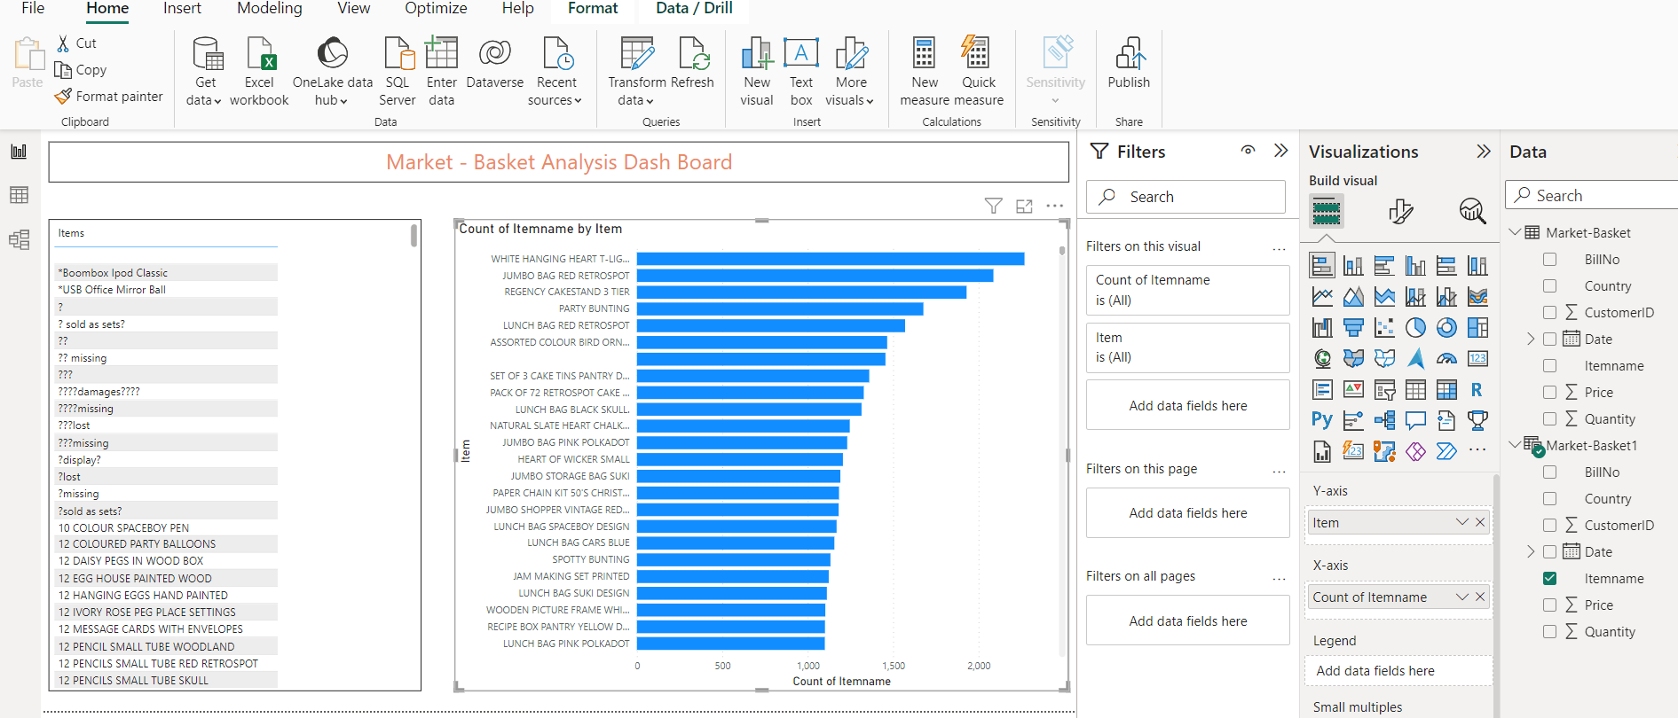
Market – Basket Analysis
8) Now, turn the right side field into bar chart and add itemname on to x-axis and rename the y-axis name to Item.

Slide 9
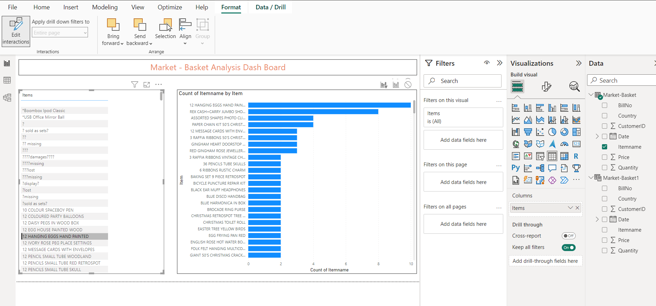
Market – Basket Analysis
Now, when ever you select an item in the list, the corresponding items brought along with that will be displayed no the bar chart.
Now, to format further, select the list and go to format click on edit interactions, on the bar chart select filter option.
Now it will be clear to know which other items bought together with selected item in the list by customers.

